Slide 1

Spring Project
Tochukwu Okereafor

Slide 2
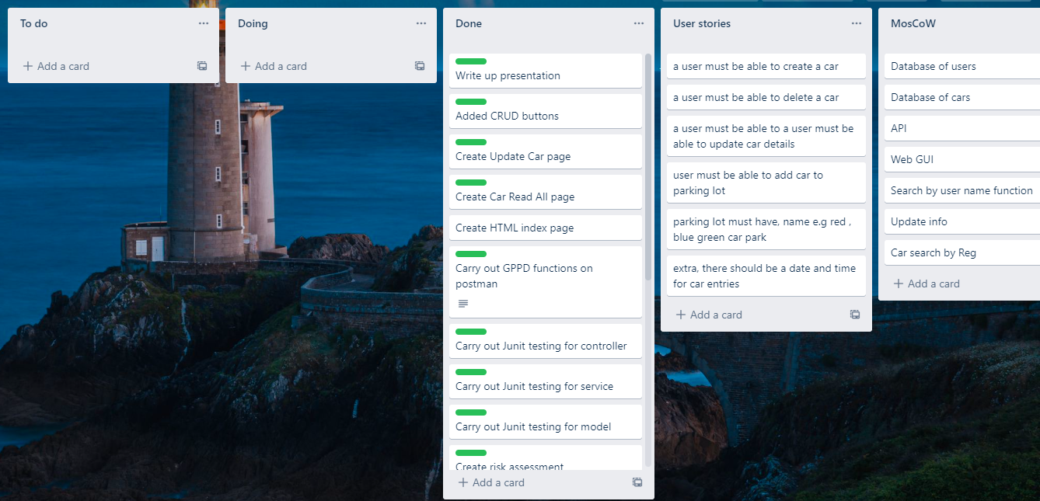
Introduction
Hello my name is Tochi since joining QA I have gained skills in:
Agile & Project Management
SQL
Git/GitHub
Project management
Java SE/EE
Front-End Development (HTML, CSS)
Approach
Created a Kanban board using Trello
Drew ERD diagrams based on requirements specification
Link: https://trello.com/b/KOrmhbJ2/user-stories

Slide 3
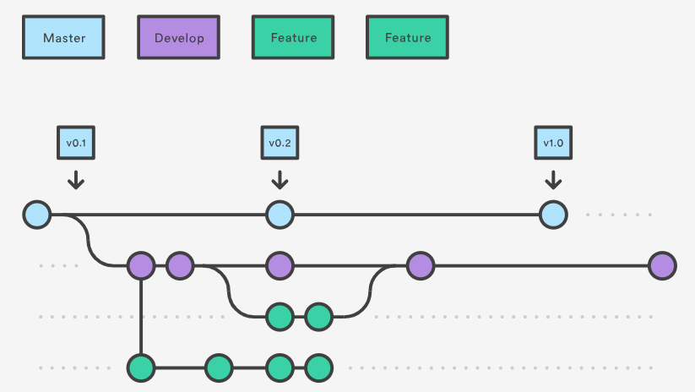
Continuous Integration
I learned and implement the Feature branch model:
Git Was used for version controlling

Slide 4
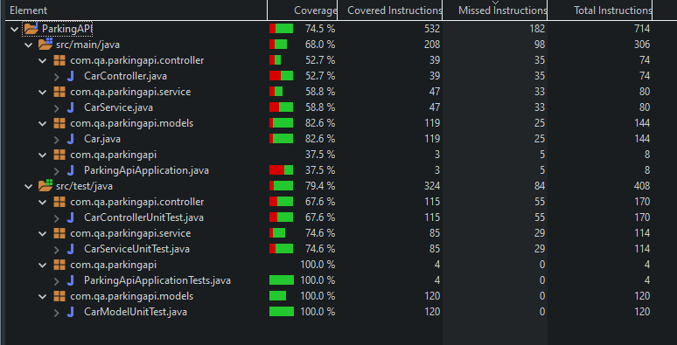
Testing
The Tests I carried out were split into three categories:
Model, Service and Controller.

Slide 5
Parking System Demo
Create a car
Update a car
Delete a car
Read all cars

Slide 6
Sprint Review
What was completed:
ERD
Risk Assessment
Documentation
Full CRUD functionality
Hit 60% testing benchmark
What wasn’t completed:

Slide 7
Sprint Retrospective
What went well:
Understanding how backend functions
Better functional grasp of Postman
Using Project management techniques
Git
Implementing Fetch function
What could be improved:
Understanding of Mockito
Writing more robust integration tests
Maven Builds
Planning poker (task estimation)

Slide 8
Conclusion
How important Git can be
A well designed backend prevents roadblocks down the line
The importance of a Kanban board as a productivity tool
The importance of testing and having a successful build

Slide 9
Thank you for listening

